Slide 1

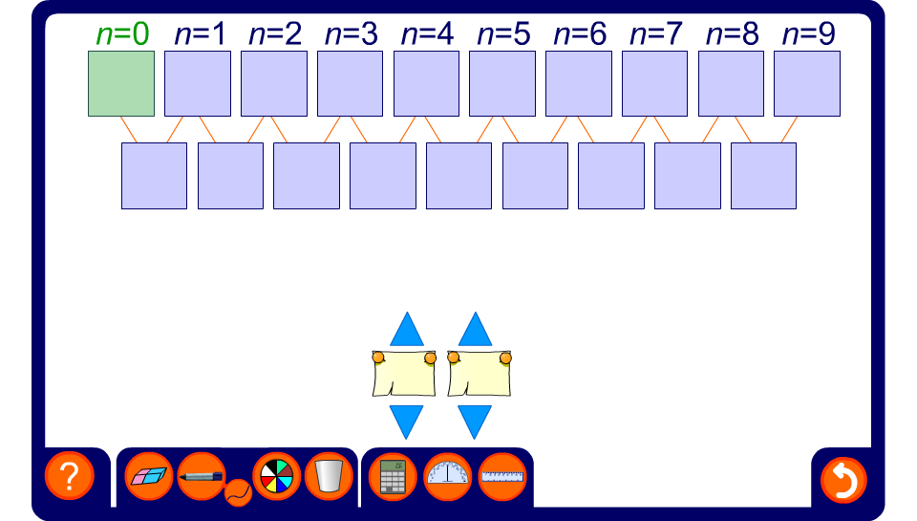


Finding the n^{th} term of a linear sequence
Notes:
Use this activity to review finding the nth tern of a linear sequences.
Reveal any three consecutive terms and ask pupils to find the remaining terms. By finding the common difference, or otherwise, ask pupils to find the rule for the nth term.
Make the activity more difficult by revealing three non-consecutive terms.
The value of the 0th term has been included so that link between its value and the rule for the nth term can be established.
Once the rule has been revealed check by substitution that all of the terms fit the rule.

